Slide 1
DocuBot:
Auto Generated PPT
Group 19: J.Mo Yang, Raleigh Christian, Alex Pearce, Jing Wang

Slide 2
Introduction
Natural Language Processing
DocuBot
How it works
Theory Behind DocuBot
User Interface
Conclusion

Slide 3
Natural Language Processing
Natural Language Processing, or NLP, is a branch of computer science (Artificial Intelligence)
Gives computers the ability to learn texts and voice much like how humans learn them
Examples:
Apple’s Siri and Amazon’s Alexa
Email Filters
Spell Check
DocuBot
A huge market
Global Market valued at USD 10.72 Billion in 2020, with CAGR of 26.84% between 2021-2026.

Slide 4
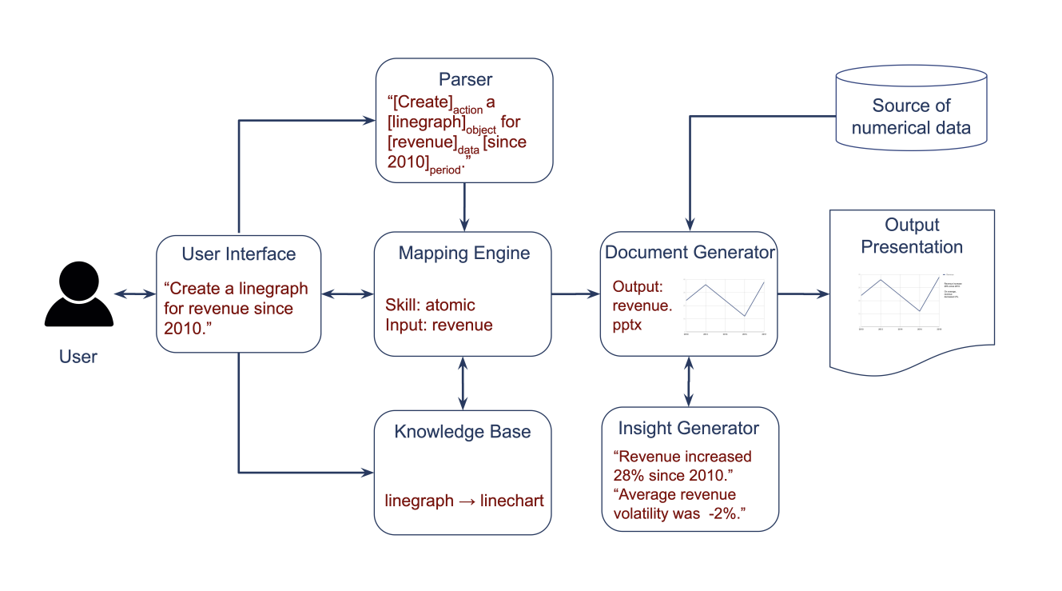
DocuBot: How it Works

Slide 5
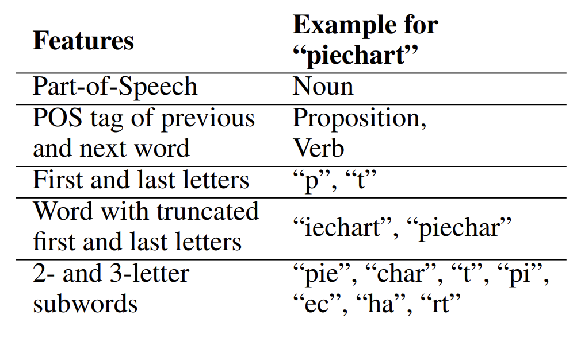
Parser
A parser is a compiler or interpreter component that breaks data into smaller chunks for easy translation into another language.
Action
Data
Object
Presentation
Notes:
A parser is a compiler or interpreter component that breaks data into smaller elements for easy translation into another language. Therefore, in the DocuBot’s case, the parser splits the input into key.
action: such as creating or updating a deck.
data: the dataset to be used as the source.
object: the type of graphic to be generated such as a piechart.
presentation: the name of the resulting presentation

Slide 6
Three Skills of DocuBot
Atomic Skills
Tasks that create or modify the contents of one slide (‘object) from a single input command.
Macro Skills
Tasks that create or modify the contents of multiple slides from a single input command.
Think of multiple atomic skills
Insight Generator Skills

Slide 7
Insight Generator
“Primitives” are used to generate insights from raw data:
Absolute Value
Minimum/Maximum
Comparison
Distance to the mean
Maps insights to human-friendly text:
Uses a template that has a sequence of interchangeable slots
“<company share> averaged <rate>% dailey return”
Ranking and selection of most important insights:
Insights are weighted
Notes:
What makes DocuBot so smart or cool is that it has the ability to learn itself, thanks to the atomic and macro skill itself, which I have introduced in the previous slide. These skills are saved as an object that the docubot could remember. However, this is just for DocuBot to understand the inputs that we are putting into. DocuBot to actually create visualizations based on the directions set forward by the users (piechart, bargraphs, etc.).
Primitives are a set of numerical functions that is modeled into a time-series. There are two example of primitives that the paper discuss, absolute value and comparison primitives. Absolute value primitives are metrics, like minimum, maximum, rolling avg. and etc. On the other hand, comparison primitives uses access to the full history of the data to compute metrics to compare to things by slicing them, like distance to the mean or comparative factor. These Sets of primitives grows over time.

Slide 8
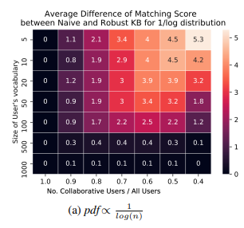
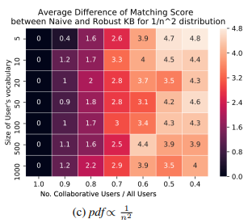
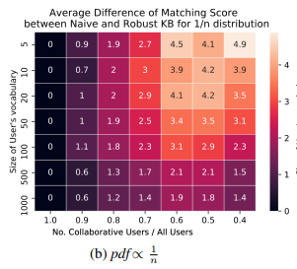
Theory behind the Docubot
Trained on NLTK library
Naive Knowledge Base
Robust Knowledge Base
Outperforms Naive Bayes
Capability to forget
Belief Score
Mapping Engine
Produced using the difference of the RBK and NKB
Notes:
The algorithms behind the Docubot are developed using the Natural Language Toolkit in Python and relies on two components to classify the task:
The Naive Knowledge Base
The Robust Knowledge Base
The Naive Knowledge Base uses multiple Naive Bayes Classifiers. This can present issues within the classification of Docubot. Therefore, JP Morgan also created the Robust Knowledge Base, which was significantly more effective at the trade off of increased computation time. The algorithms and classifiers in the Robust Knowledge Base, compared to the Naive Knowledge Base, have the capability to determine and forget incorrect inputs
Every time a user interacts with DocuBot to choose a sub-concept, the RKB updates the discrete probability distribution and renormalizes the score. It generates a Belief Score for each input to prompt for clarification.
It’s another layer to catch mistakes
So, the Knowledge Bases track inputs and terms.
Mapping engine is an algorithm to map the concepts present in each natural language instruction into structured actions. The Mapping Engine enables DocuBot to use the skills, as J.Mo described. It synthesizes information and interacts with the Knowledge Base, Parser, and the User Interface to determine content creation.
Bernoulli:
Yes/No inputs and result
Easy interpretation of results
Used frequently in text classification
Multinomial
Accommodates more than 1 class
yes/no/maybe/strongly likely/ likely/ neutral
Gaussian
Can be applied to continuous or discrete data
Structured around a Gaussian distribution for each class
Based on the distribution of articles for say a quarter, what is it most likely to contain?

Slide 9
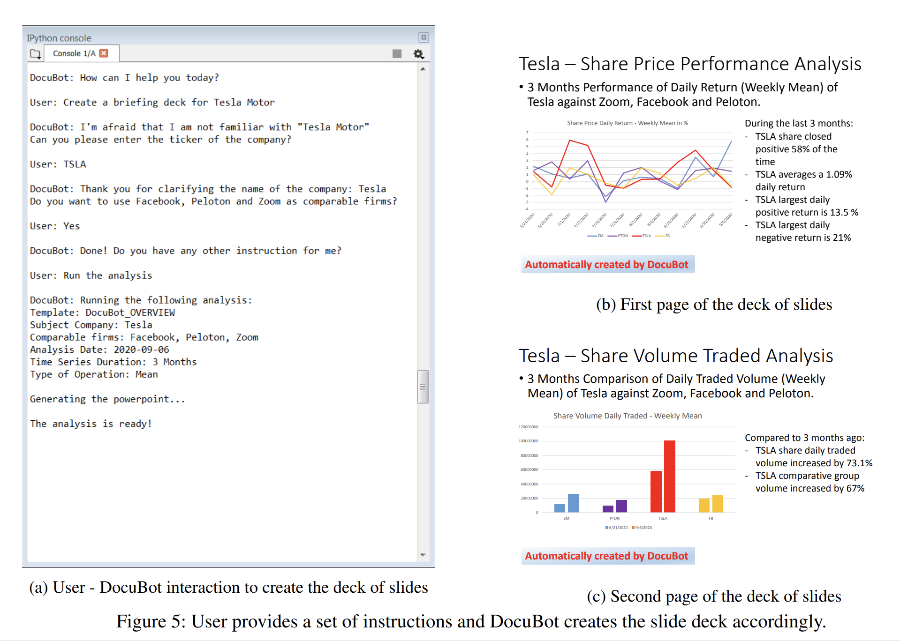
DocuBot: User Interface

Slide 10
Conclusion
Natural Language Processing allows computers to have the ability to process and learn text and voice much like how humans learn them
NLP is used in a variety of ways in our everyday lives
It makes our jobs easier and more efficient

Slide 11
Sources
https://arxiv.org/pdf/2010.01169.pdf
https://www.ibm.com/cloud/learn/natural-language-processing
https://www.mordorintelligence.com/industry-reports/natural-language-processing-market#:~:text=Market%20Overview,period%20(2021%2D2026).

Slide 12
R Notes
Notes:
c) Here in Exercise c, we are going to use K-means clustering, where K=3 to compare to the true class labels to the class labels obtained by clustering. So we set K=3,. We are running nstart=25 to obtain an optimum. The cluster assignments of the observations are shown below. We see our simulated dataset is perfectly clustered into 3 classes. We can also see them in the graph.
d) And what if we cluster the observations to K=2, We see the second class is not clustered correctly.
We also use $tot.withinss here. And $tot.withinss is the total within-cluster sum of squares, which we seek to minimize by performing K-means clustering. We can see the result is high. So, we can confirm that the second class is not good.
e) Now we perform K = 4. So, from the confusion matrix, we can see that the result shows 4 classes instead of 3. And one of them was split into 2 classes and then produced an extra class. After we run tot.withinss we can see the result is still high, so it is not perfect.
f) Next, we are going to perform K = 3 on the first two principal component score we got from the first question. We can see the result remains the same as perfectly clustered into 3 classes.
g) Finally, we are using the scale() function, perform K = 3 on the data after scaling each variable to have standard deviation =1. We can see that scaling didn't change the clustering, and 3 classes seem to be to optimal number of clusters, which is exactly we had by using PCA method.

